Slide 1
Project: Web Browser
Team Name: XAM
Team Members:

Slide 2
Introduction
A web browser is a software application for accessing information on the World Wide Web. Each individual web page, image, and video is identified by a distinct URL, enabling browsers to retrieve and display them on the user's device.

Slide 3
Architecture of a Browser
Data Persistence
User Interface
Browser Engine
Rendering Engine
Networking
Java Script Interpreter
UI

Slide 4
How Browsers work?
192.168.1.4 192.168.1.4
www.google.com HTML & Other Files
Web Page www.google.com
DNS Server
Google.com- 192.168.1.4
Web Browser
Server
user

Slide 5
Tools and technologies
# Visual Studio for IDE
# c Sharpe

Slide 6
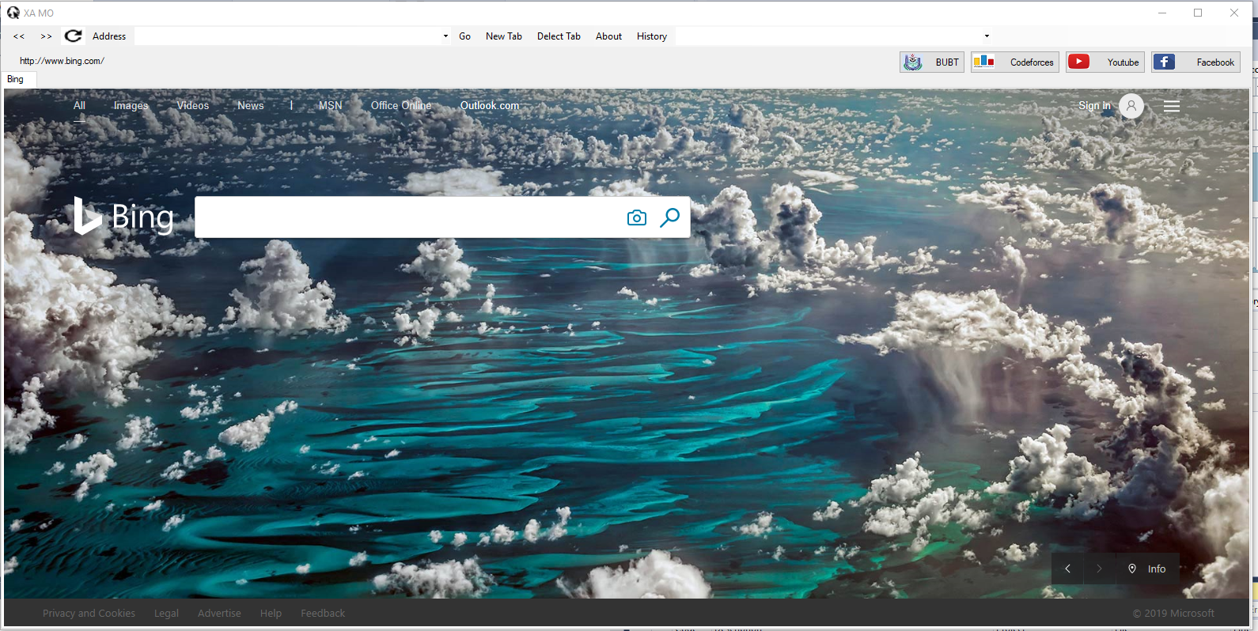
Graphical user interface

Slide 7
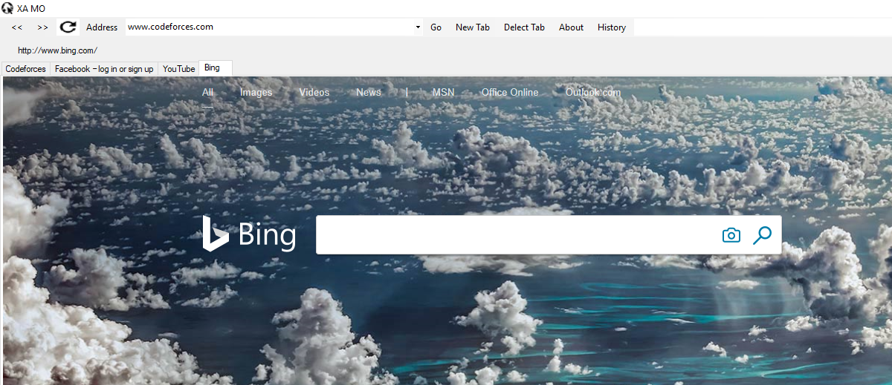
Feature
New Tab

Slide 8
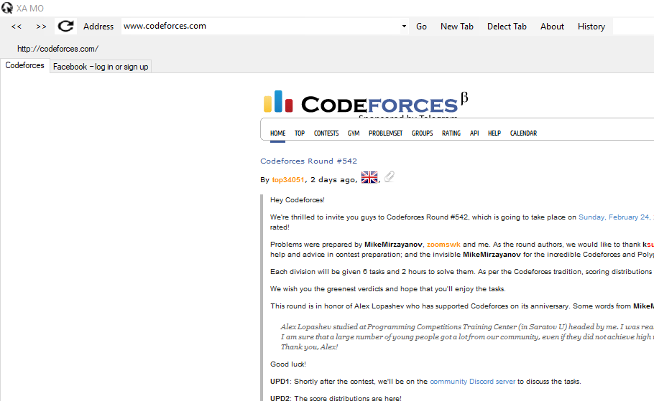
Feature
Delete Tab

Slide 9
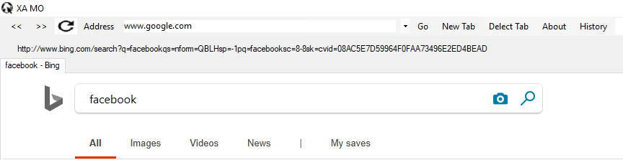
Feature
Address Link

Slide 10

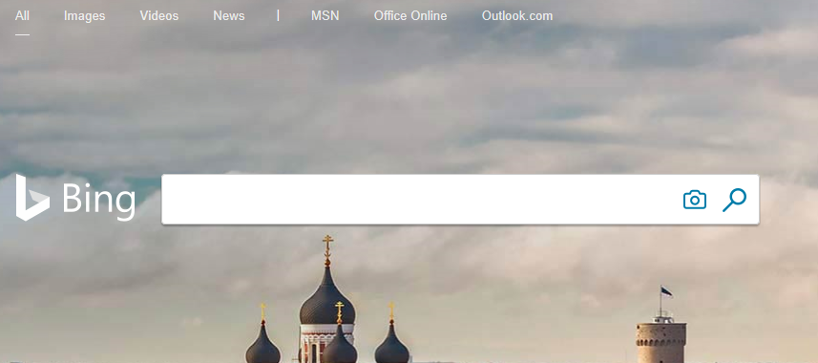
Feature
Search Engine

Slide 11
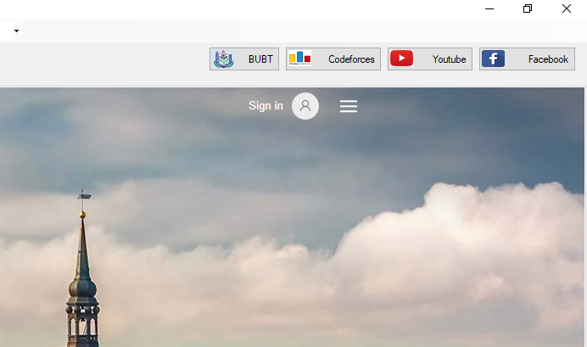
Feature
Seed Dial

Slide 12
Feature
History

Slide 13
Thanks To Everyone

